Slide 1
Powered by
Reputation Management

Slide 2
1. Review Management
We aggregate reviews from all of the top sites so you can easily monitor what customers are saying about your clients – in real-time!
CUSTOMER SURVEYS
We create engaging surveys that are sent through phone text messaging and email to your customers. This is a proactive approach to gather your best reviews and catch unhappy customers before they damage your reputation online
REVIEW SITE
We create a microsite that also serves as a good SEO tool for quality backlinks to your main website. This displays your best reviews
REVIEW MONITORING
Never miss a word with real-time notifications of new customer feedback
REVIEW MANAGEMENT
We monitor and respond to all your reviews from all your social sites
REVIEW MARKETING
Amplify customer voices and let your online reputation promote itself. We push your best reviews out to your social platforms and integrate your reviews onto your website through an API.

Slide 3
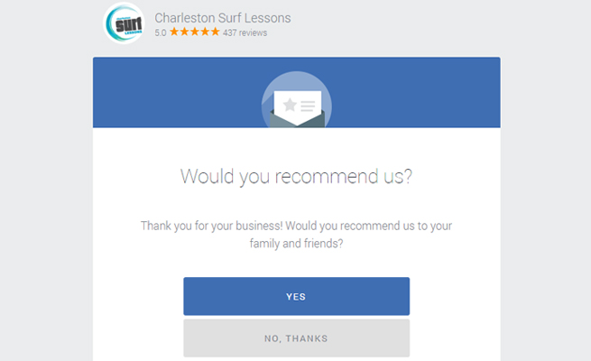
CUSTOMER SURVEYS: Identify If Someone Is Going to Write A Positive Or Negative Review Before Sending Them To A Top Review Site

Slide 4
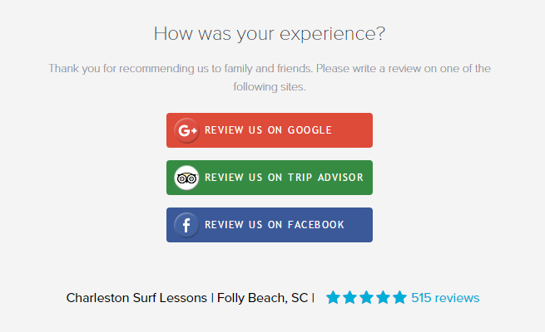
Happy Customers Will Be Sent To Top Review Sites

Slide 5
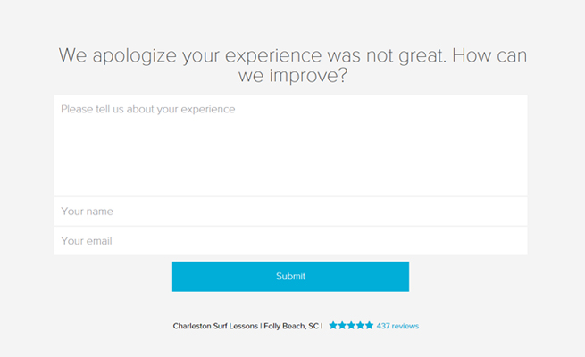
Unhappy Customers Will Be Sent To A Private Feedback Area

Slide 6
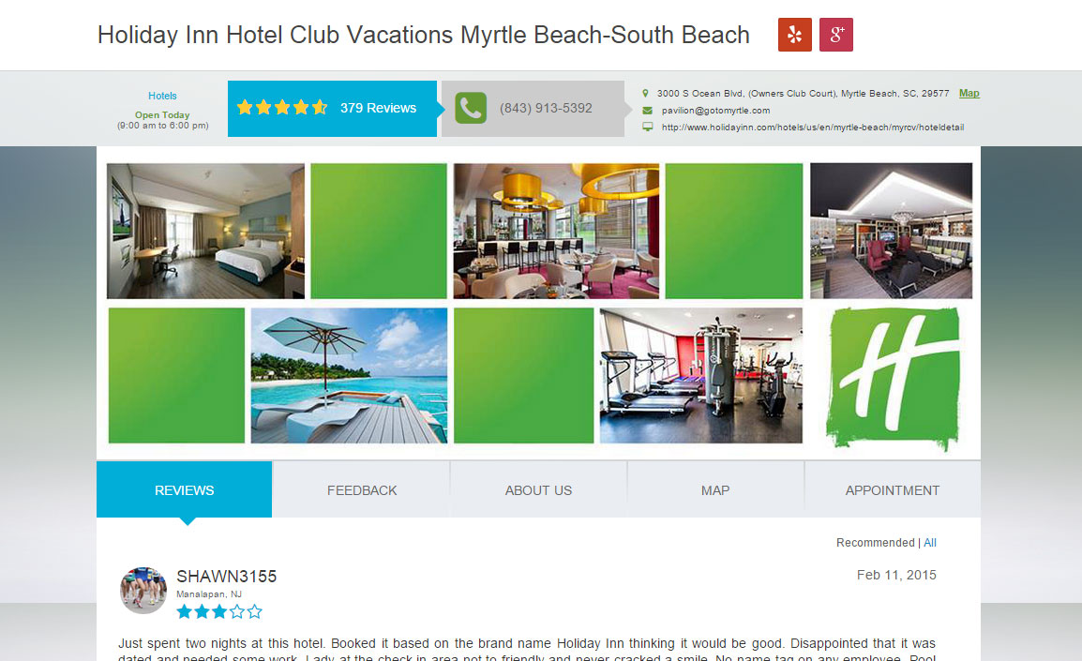
REVIEW SITE: We Will Create a Custom Review Site which
Will Increase SEO Exposure

Slide 7
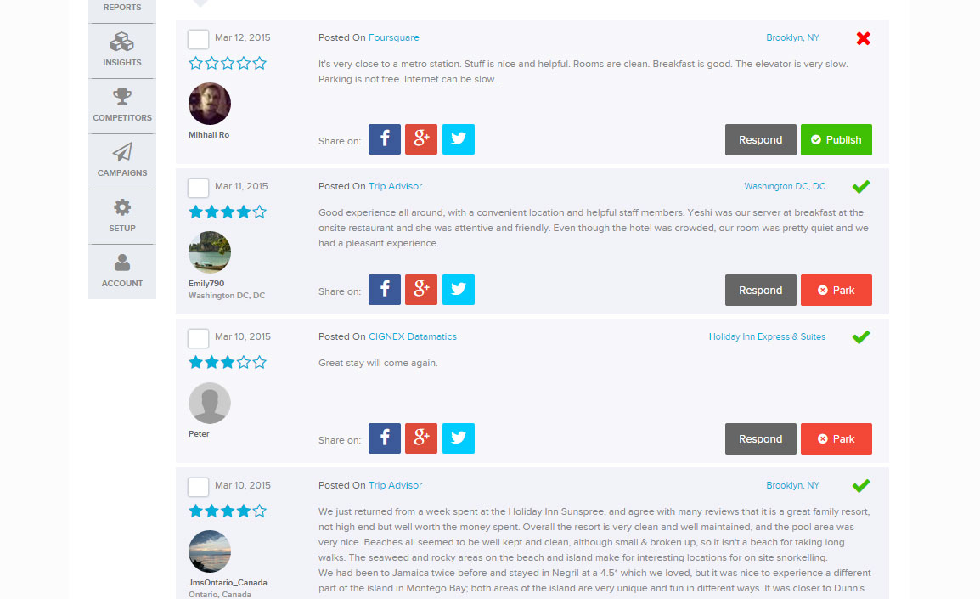
REVIEW MONITORING: Managing All Your Clients’ Reviews In One Location - Will Save Time & Allow For Faster Reaction

Slide 8
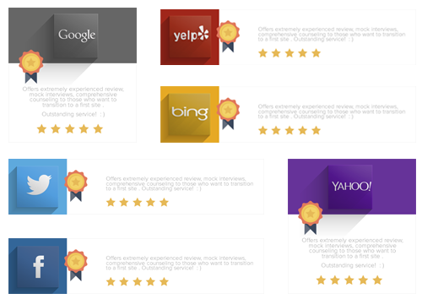
REVIEW MARKETING: Positive Review Distribution
We amplify and distribute positive reviews throughout the web. Getting more positive reviews in front of more people.

Slide 9
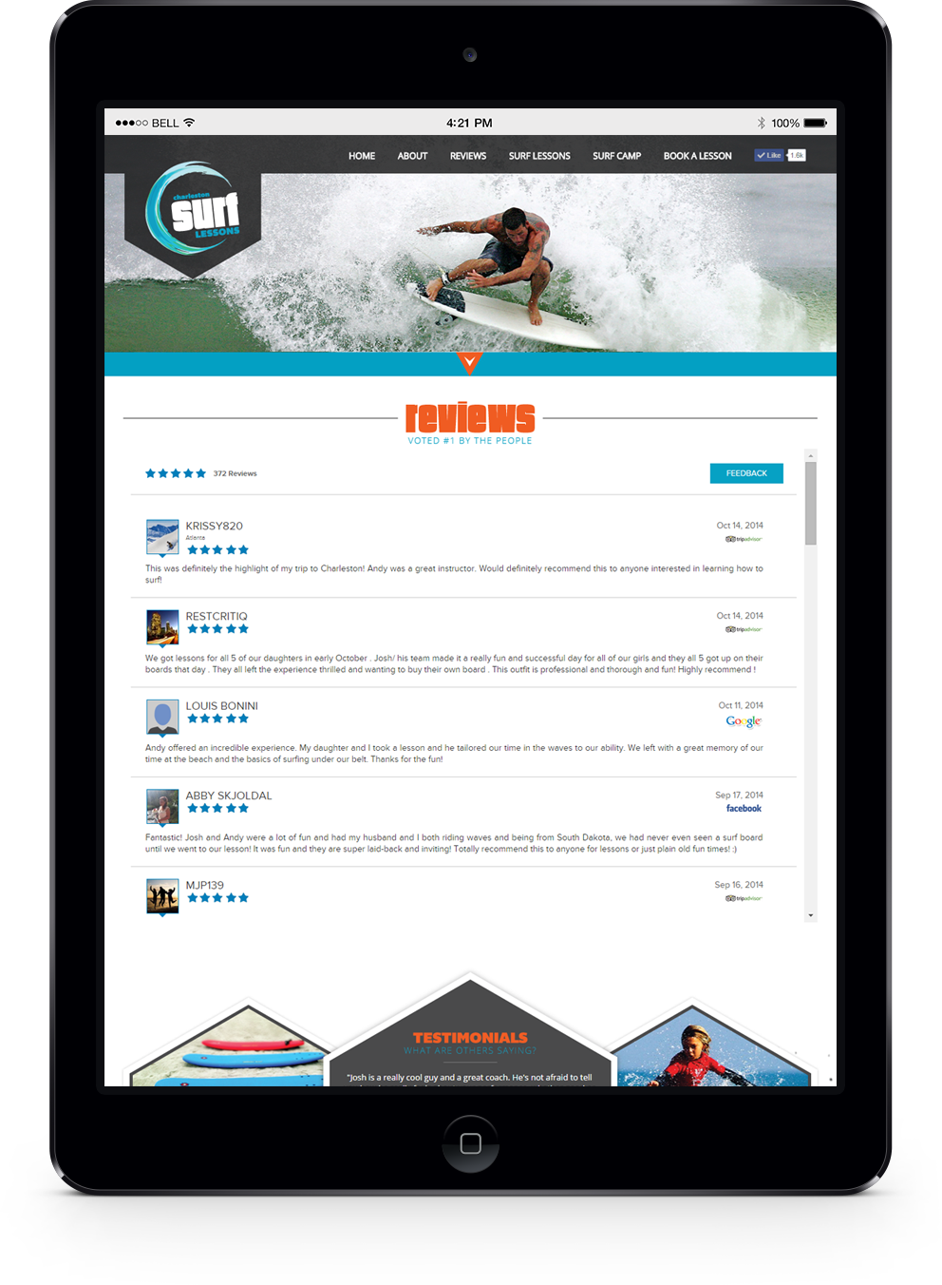
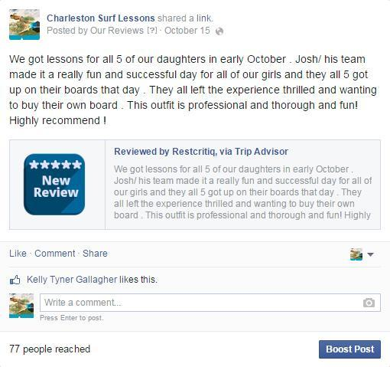
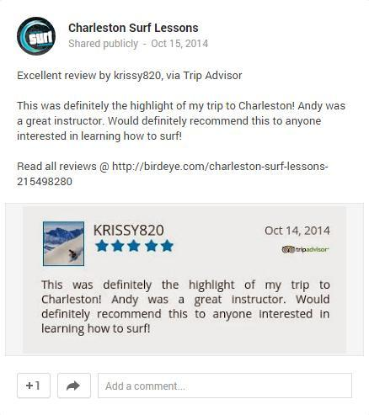
We Post the Best Reviews On Facebook, Google+, & Twitter
Will Increase Conversions & Increase Social Conversations
Website
Facebook & Google+

Slide 10
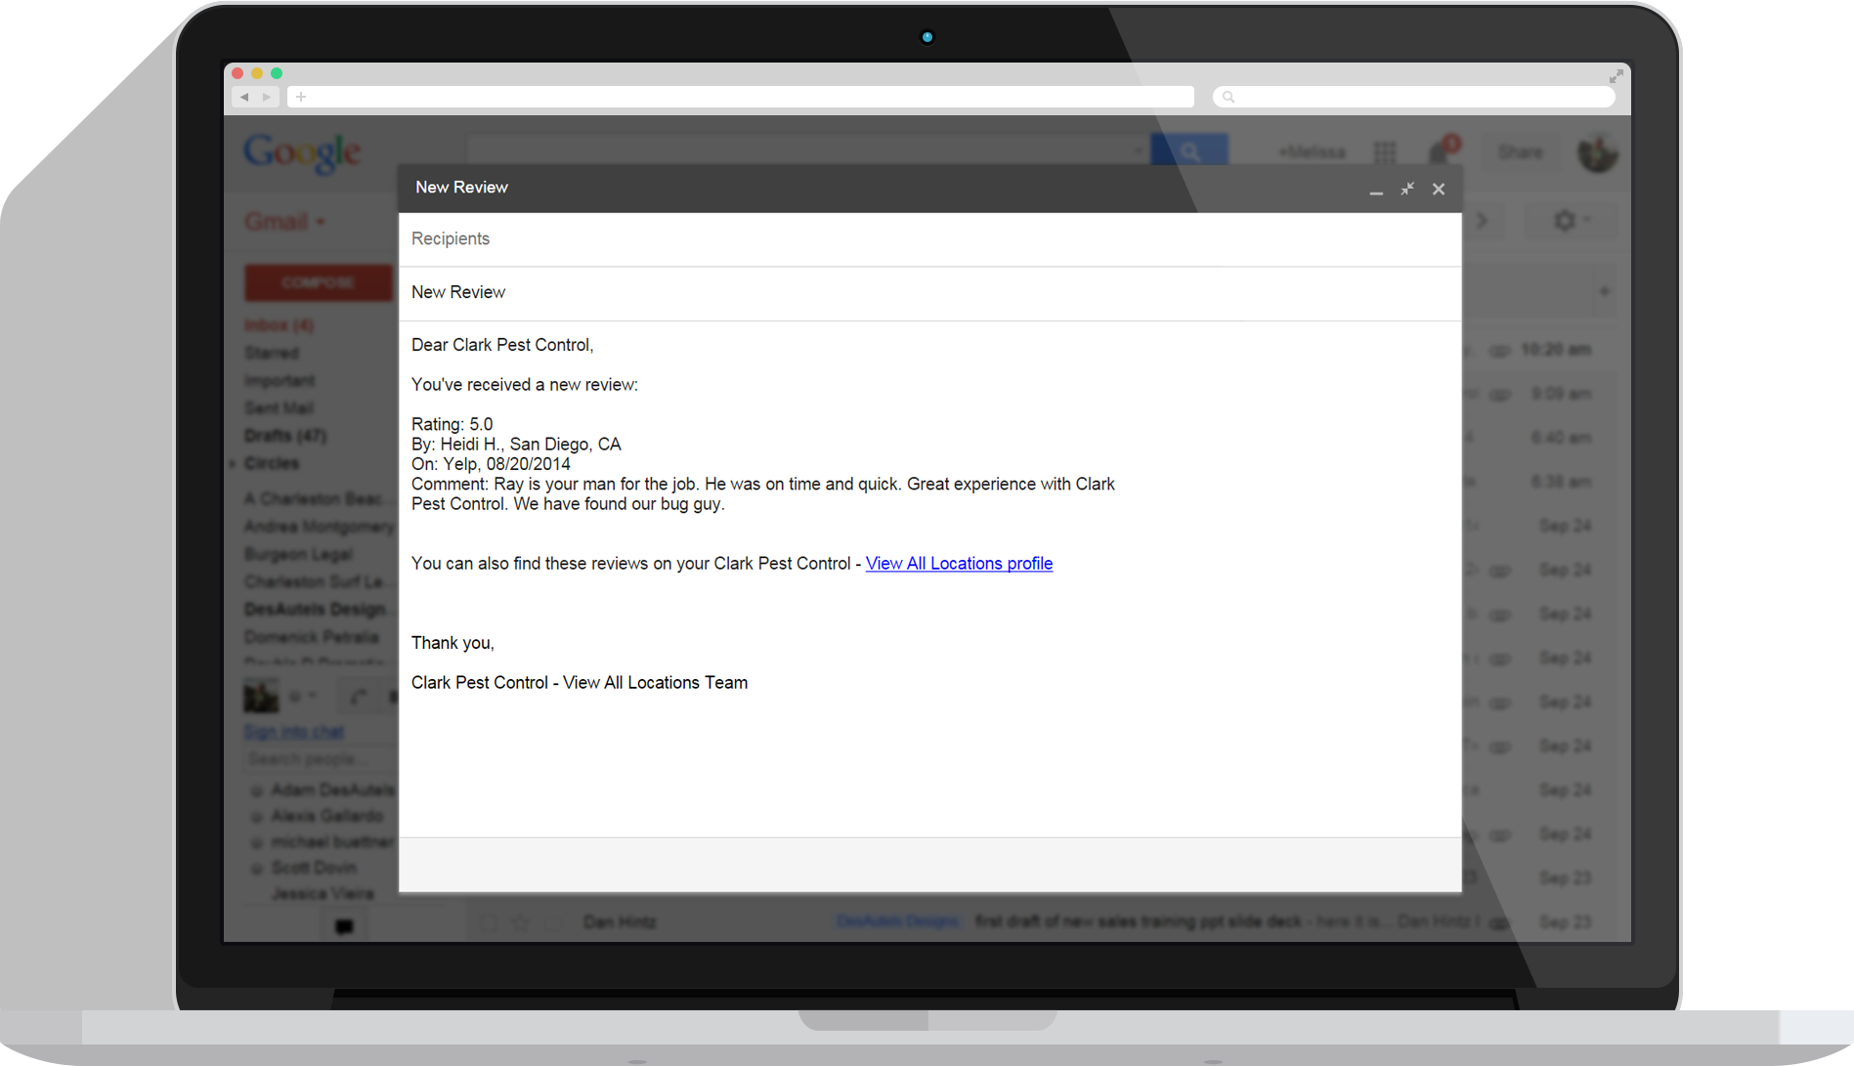
WE INTERGRATE A REVIEW API ON YOUR Website! Amplifying Your Reputation On Google - Will Increase Google SEO Traffic & Conversion

Slide 11
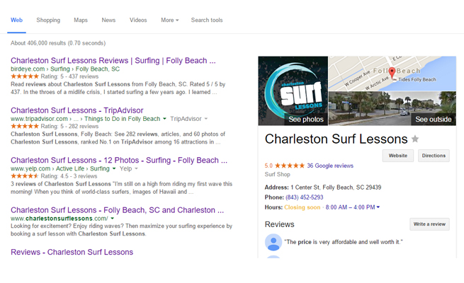
The Goal Is To Get More Revenue For You By
Increasing Your Online Reviews Throughout The Web

Slide 12
Increase Your ROI
Positive reputation equals revenue.
Get a 5-9% increase in revenue with
1-star improvement in rating. Be found on Google organic search with positive reputation.
Notes:
REVIEW MARKETING
Positive reviews = Revenue (1-star = 5-9% increase; 5-stars on Google ads = 17% increase)
We push your positive reviews on Google page 1, On Top sites like Google+ / Yelp / Yahoo, On your website, On social media (FB/TW), On 50+ local directories (e.g. CityGrid – yellowpages, citysearch, bing, kudzu….50+ sites)
How do we do this
Sites your business controls: your website, your blog, review site built by BirdEye, Facebook app, Twitter app ➔ Positive reviews are auto-posted
3rd party sites where BirdEye has signed syndication deals ➔CityGrid : 50+ sites in this network; 140M users
Sites which mandate that “users directly post reviews and no one can post on behalf of users” (Yelp / Google+ / Angie’s List) ➔ SHARE reviews OR Send users directly to Yelp to get reviews…
AGGREGATION IS NOT CONNECTED TO SYNDICATION?
New review 5-star comes in on BirdEye platform: Where can we send it?
- Sites your business controls : YES
- 3rd party sites where we have syndication deals : YES
- Share on sites that mandates users to directly write reviews : SHARE : YES
New review 5-star comes in via YELP aggregation: Where can we send it?
- Sites your business controls : YES (CROSS POSTING)
- 3rd party sites where we have syndication deals : NO
- Share on sites that mandates users to directly write reviews : SHARE : NO

